Slide 1
Sequential Face Ordering With Manifold Learning Algorithms
MATH5473/CISIC5011 Project 2 Presentation
Shunpeng Yang 20924197

Slide 2
Outline
Introduction
Task
Methods
Results
Conclusion

Slide 3
Introduction
Face pose determination: crucial task in human-computer interaction (HCI)
enable the detection of a person's head orientation
provide insights into their focus of attention
In this project, reorder the set of images
to display the sequential progression of the head's overall pose
enable the visualization of changes in orientation over time

Slide 4
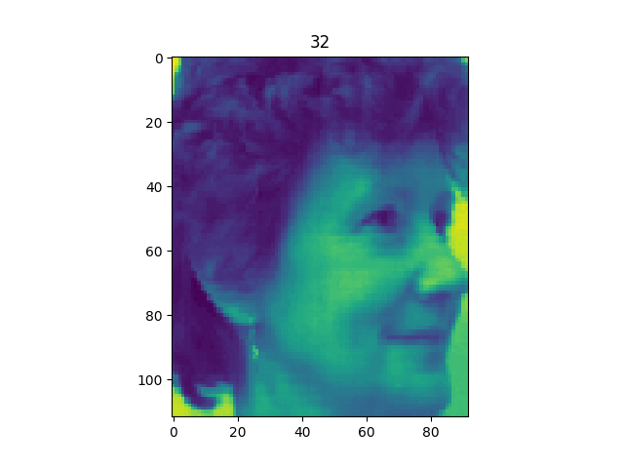
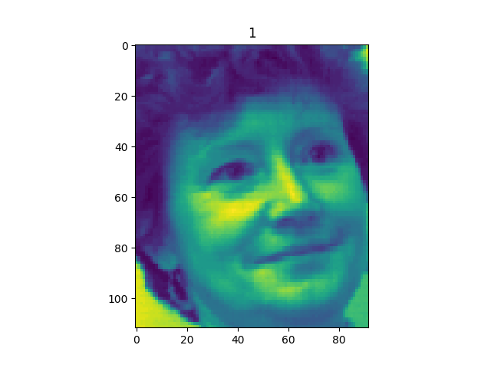

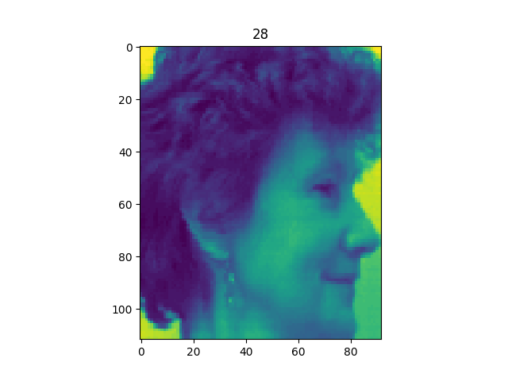
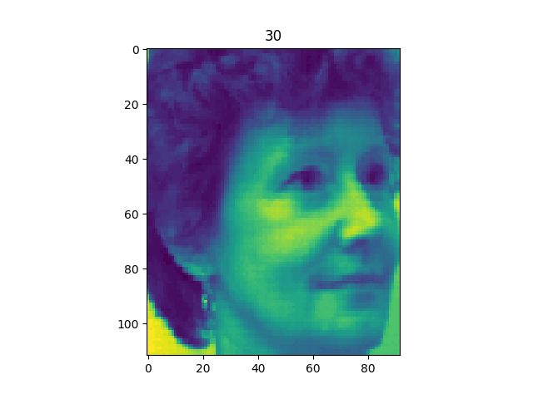
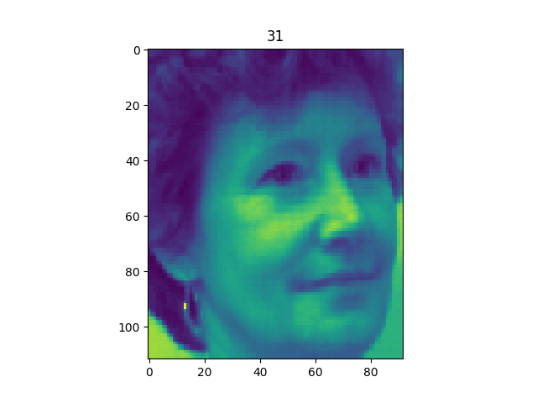
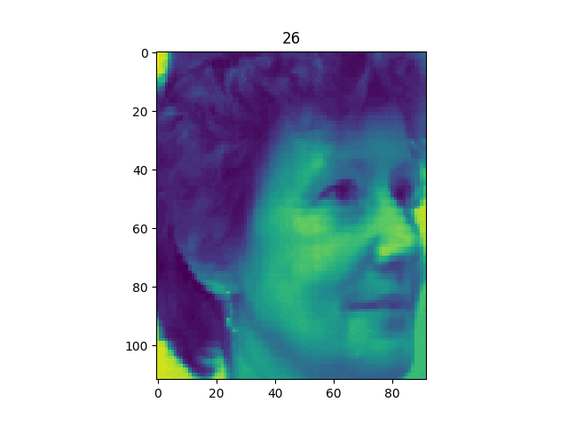
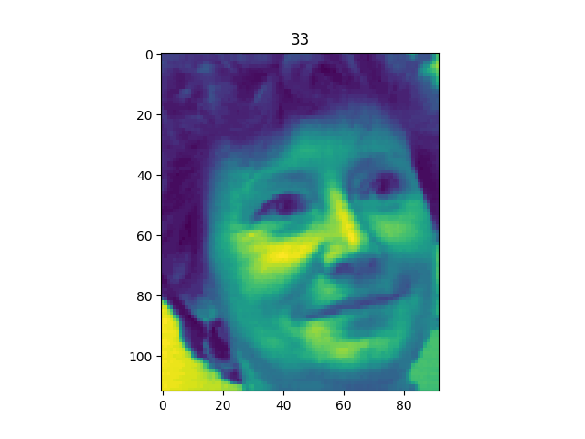
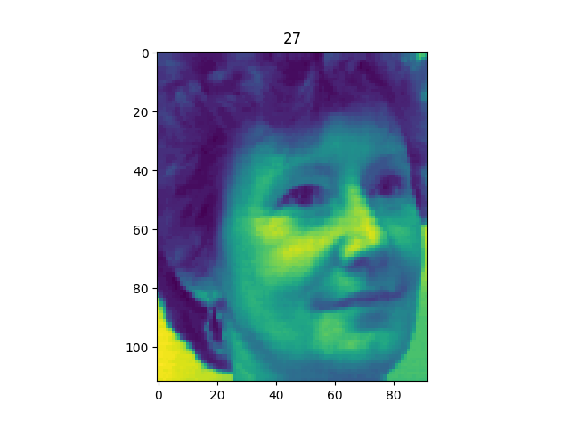
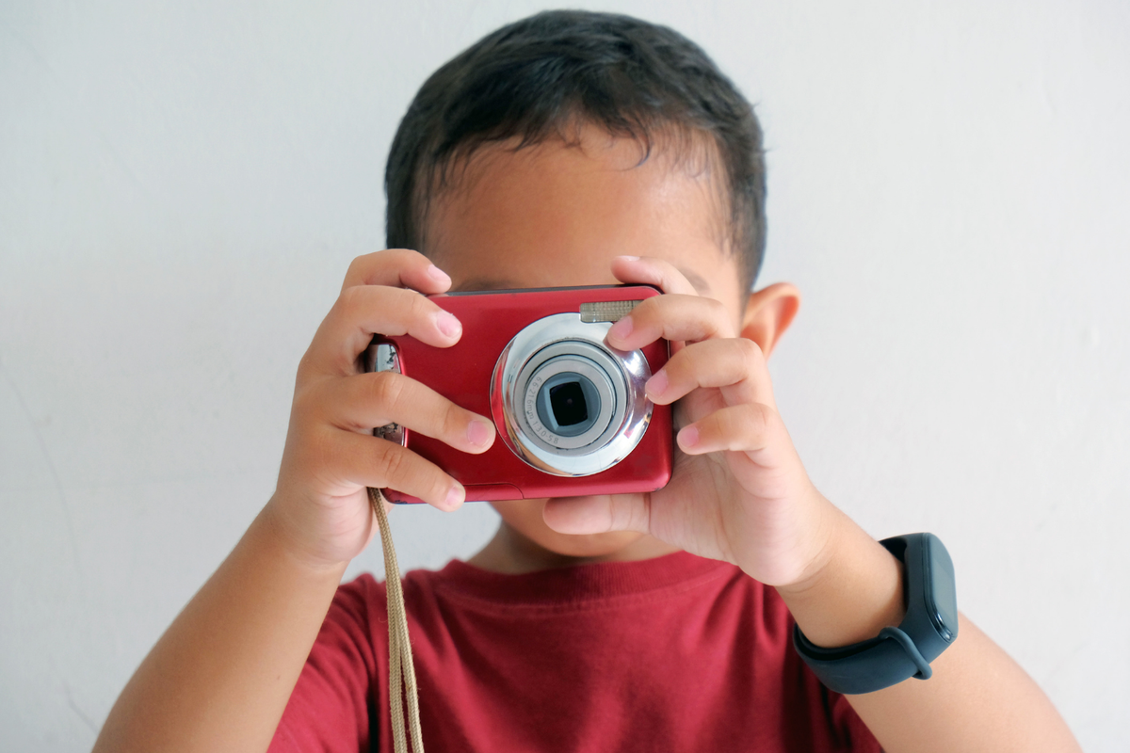
Task
33 unordered images
Rotate Head
Task: reorder the set of images to display the sequential progression of the head's overall pose

Slide 5
Methods
Task: reorder the set of images to display the sequential progression of the head's overall pose
Manifold learning techniques
extract the underlying structure of the dataset
project the images onto a lower-dimensional space
effectively uncover patterns and relationships among the images
Target: generating a meaningful ordering of the images
Various commonly used algorithms + Comparison based on their performance
Chosen Algorithms:
Diffusion Map
Multiple Dimensions Scalling (MDS)
Isomap
Locally Linear Embedding (LLE) and modified LLE (MLLE)
Local Tangent Space Alignment (LTSA)
T-distributed Stochastic Neighbor Embedding (t-SNE)

Slide 6
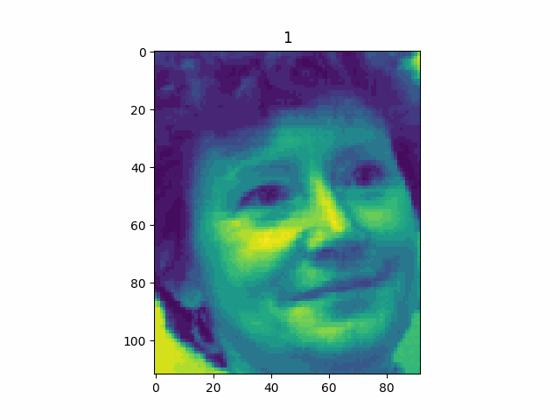
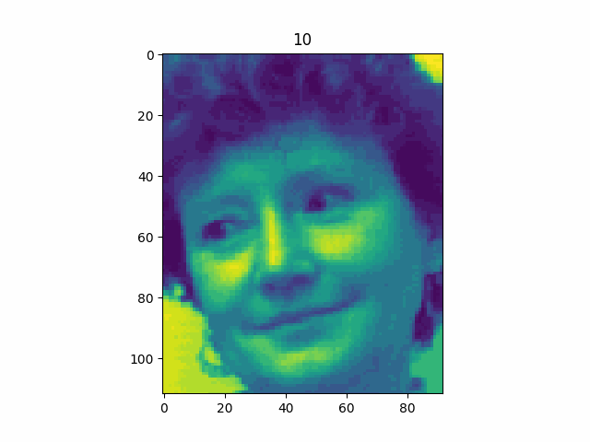
Results
Unordered
Isomap
Diffusion Map
MDS
LLE
MLLE
LTSA
T-SNE

Slide 7
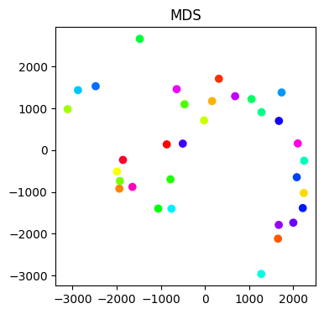
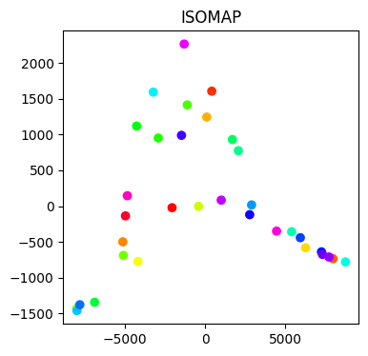
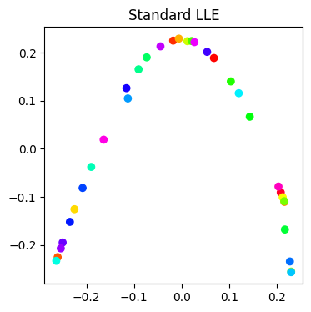
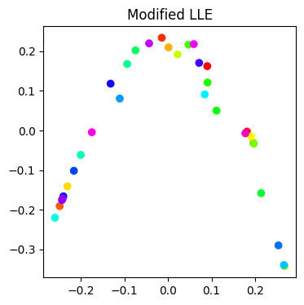
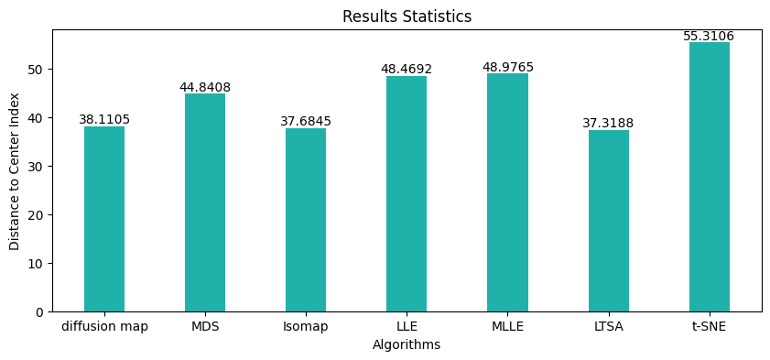
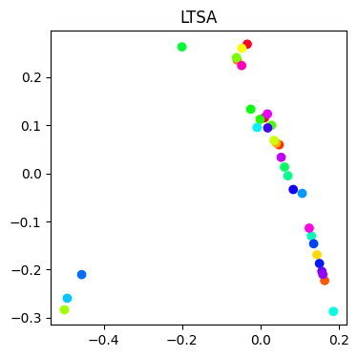
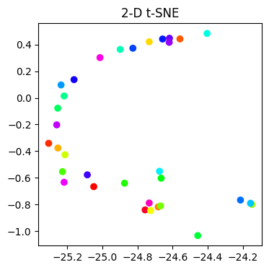
Results
best
poor performance

Slide 8
Conclusion
All methods we explored show reasonable ordered index and s-SNE has poorest performance
LTSA exhibits the lowest distance to the averaged index.
The performance of diffusion map, Isomap and LTSA are similar.
That’s All

